Slide 2
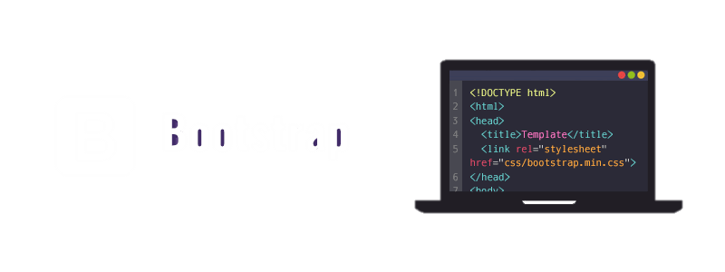

Slide 3
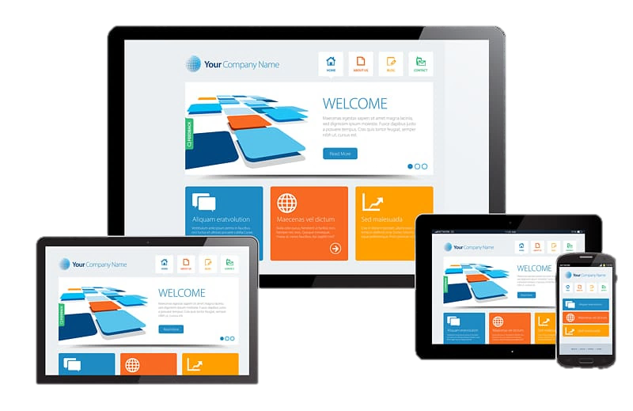
Contents
Introduction
History
Why bootstrap ?
It includes !
How to use it ?
Containers
Grid
Working with bootstrap !
Bootstrap 5 is coming !
Conclusion
reference

Slide 4


INTRODUCTION
Bootstrap is a free, open-source, and one of the most popular front-end framework.
Developed by twitter for creating responsive web applications.
It is a collection of CSS and JavaScript.
Bootstrap is the 6th most starred project on Github, with more than 135,000 stars.

Slide 5
HISTORY
Developed by Mark Otto and Jacob Thornton at twitter.
It was renamed from Twitter Blueprint to Bootstrap.
Released as an open-source product on August 19, 2011 in
Github.
It consist of 3 major versions, Bootstrap 2, 3 & 4.

Slide 6
HISTORY
Bootstrap v2.0
Released on January 31, 2012.
Built-in support for Glyphicons.
Supports responsive web designing.
Bootstrap v3.0
Released on August 19, 2013.
Redesigned components to use flat design and a mobile first approach.

Slide 7
HISTORY
Bootstrap v4.0
The first alpha version of Bootstrap 4 was released on August 19, 2015.
The first beta version was released on August 10, 2017.
Mark Otto suspended work on Bootstrap 3 to free-up time to work on
Bootstrap 4.
V4.0 was finalized January 18, 2018.

Slide 8
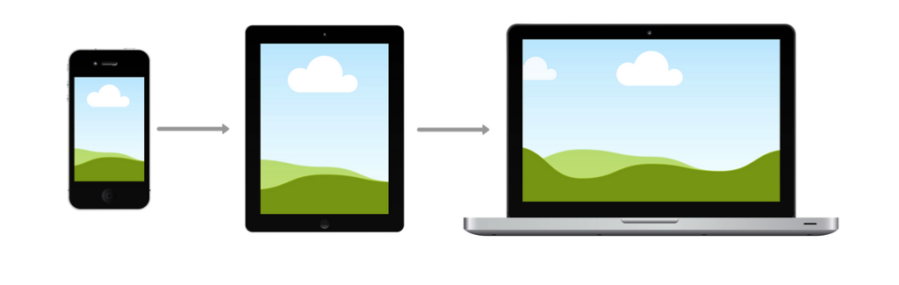





WHY BOOTSTRAP ?
Mobile first approach.
Browser support.
Etc.

Slide 9


WHY BOOTSTRAP ?
Easy to get started.
Responsive design.

Slide 10



IT INCLUDES !
It includes 3 files,
bootstrap.min.css
jquery.min.js
Bootstrap.min.js

Slide 11
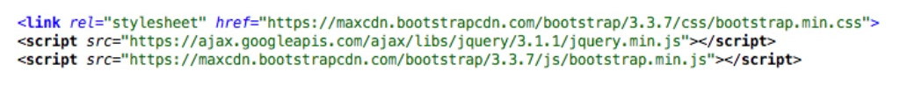
How to use it ?
We can include it either by using CDN or downloaded files.
Syntax for using CDN (Content Distribution Network)
Syntax for using downloaded files
<script type = “text/javascript” src = “jquery.min.js”></script>
<script type = “text/javascript” src = “bootstrap.min.js”></script>
<link rel = “stylesheet” type = “text/css” href = “bootstrap.min.css”>

Slide 12
Containers
It has a concept of containing elements to wrap site contents.
There are two types of containers
.container
Class used for a responsive fixed width.
.container-fluid
Class used for a full-width container.

Slide 13
Containers
Syntax for using .container
<div class = “container”>
…
</div>
Syntax for using .container-fluid
<div class = “container-fluid”>
…
</div>

Slide 14
Grid
It is a structure (Usually 2D) made up of series of intersecting straight (Vertical/Horizontal) lines.
It is used to structure the contents.
It is a very effective method to create a consistent layout rapidly & effectively using Html & CSS.
Makes the website easy to scan & reduces the load on users.

Slide 15
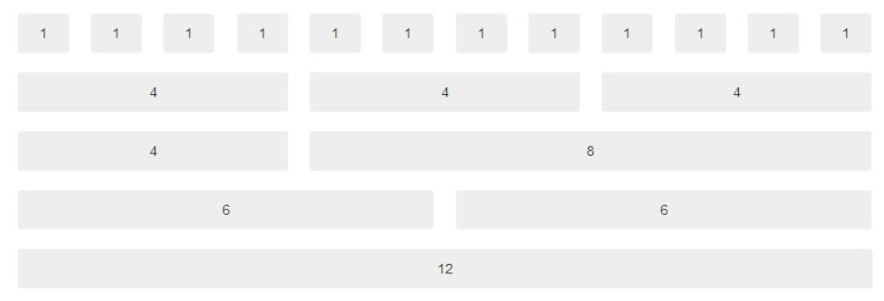
Grid Structure

Slide 16
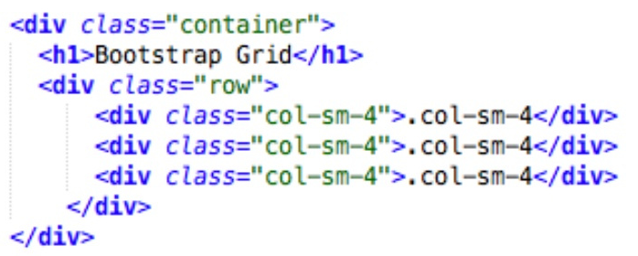
Grid Example
It allows up to 12 columns across the page.
We can divide the containers in rows and each row in columns with space multiple of 12.

Slide 17
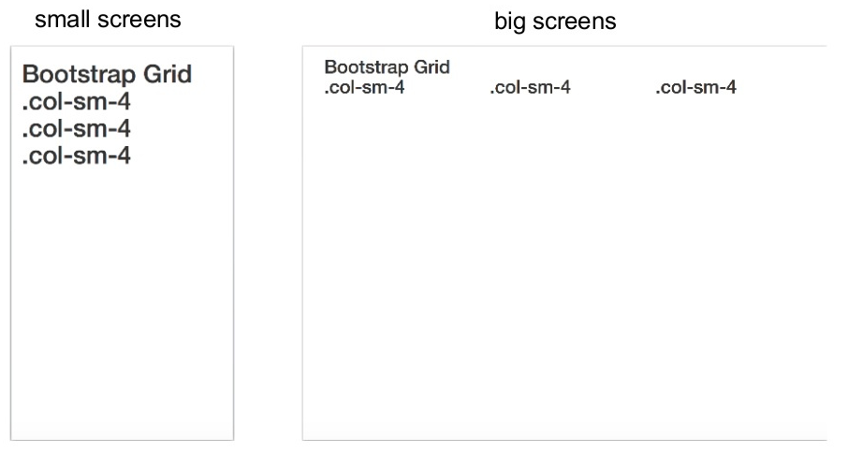
Grid Working
We can use any combination that the sum be equal to 12.
Responsive Bootstraps' grid system with 3 columns

Slide 18
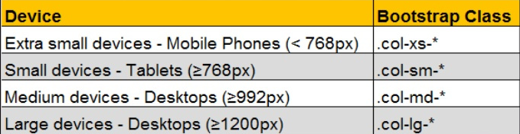
Grid Classes

Slide 19
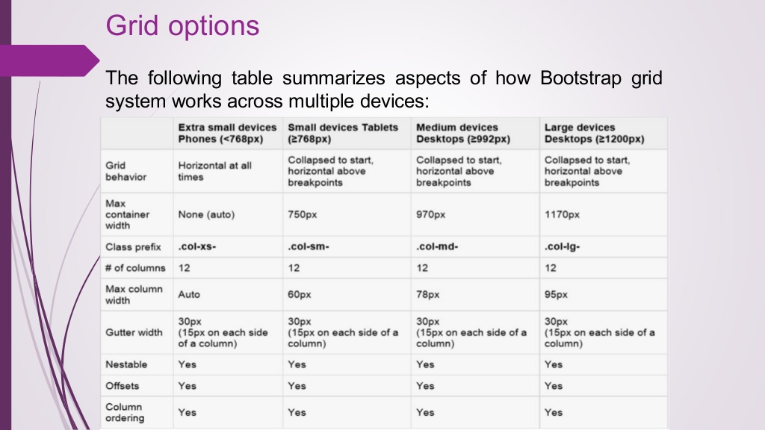
Grid Options

Slide 20

Working with Bootstrap !

Slide 21
Bootstrap Tables
There are 4 main classes for tables
table
table-striped
table-bordered
table-hover
table
Basic table style with just some light padding and horizontal dividers.
<table class = “table”> … </table>

Slide 22
Bootstrap Tables
table-striped
Used to get zebra-striping to any rows with in the <tbody>
<table class = “table table-striped”> … </table>
table-bordered
Used to get borders surrounding every element and rounded corners around the entire table.
<table class = “table table-bordered”> … </table>

Slide 23
Bootstrap Tables
table-hover
Used to get a light grey background to rows while the mouse cursor come over it.
<table class = “table table-hover”> … </table>
table-condensed
Used to make tables more compact by cutting cell padding in half.
<table class = “table table-condensed”> … </table>

Slide 24
Table – Contextual Classes
It is used to color table rows / individual cells.
There are 5 contextual-classes
active
success
info
warning
danger

Slide 25
Table - Responsive
By wrapping any <table> in table-responsive class we can make a responsive table.
<div class = “table-responsive”>
<table class = “table”>
….
</table>
</div>

Slide 26
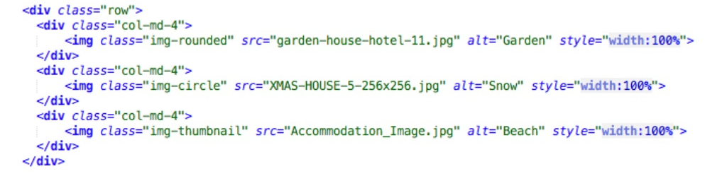
Bootstrap Images
It consist of 3 main classes
img-rounded
img-circle
img-thumbnail

Slide 27
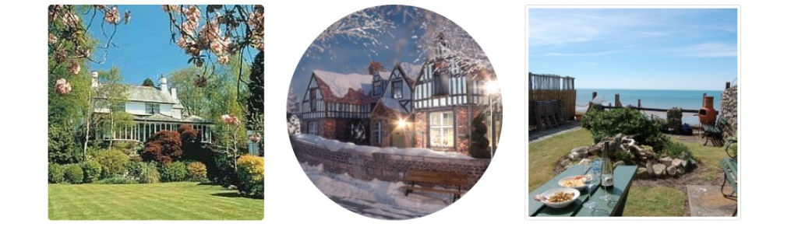
Bootstrap Images

Slide 28
Image - Responsive
We can also make responsive images by using img-fluid class.
<img src = “…” class = “img-fluid” alt = “Responsive_Image” />

Slide 29
Carousel
It is a slideshow for cycling through elements.
We can use the carousel slide class to create slideshow.
Syntax is,
<div id="demo" class="carousel slide" data-ride="carousel">

Slide 30
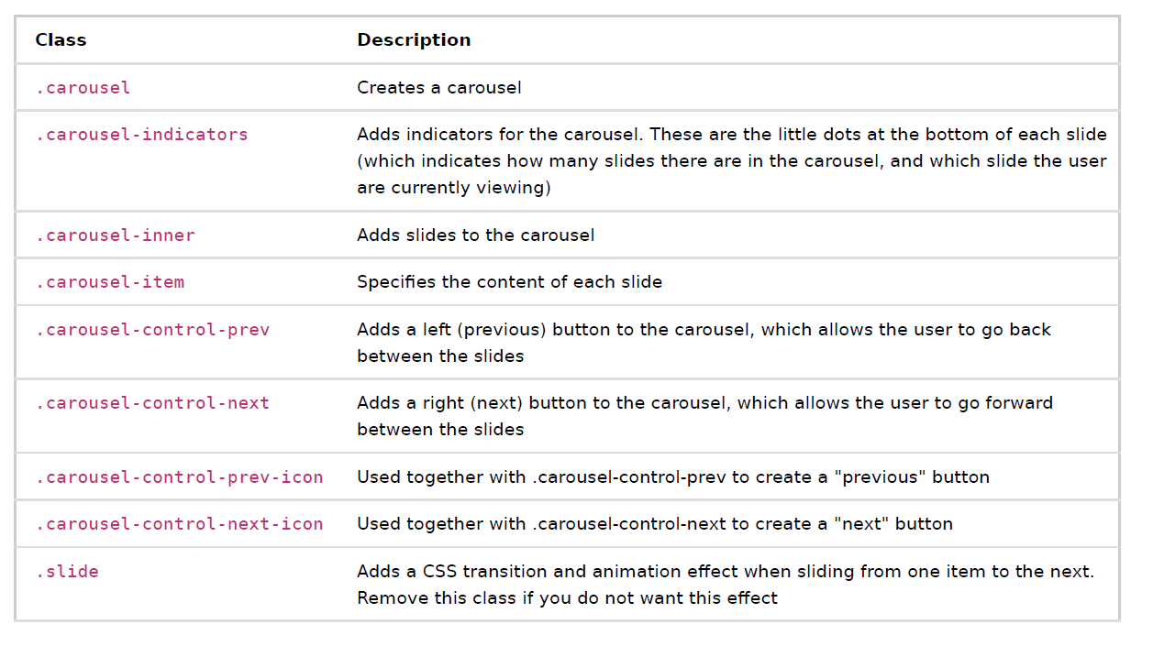
Carousel

Slide 31

Carousel

Slide 32
Bootstrap alerts
It provides an easy way to create predefined alert messages.
They are created with the alert class followed by the one of the 4 contextual classes.
alert-success
alert-info
alert-warning
alert-danger

Slide 33
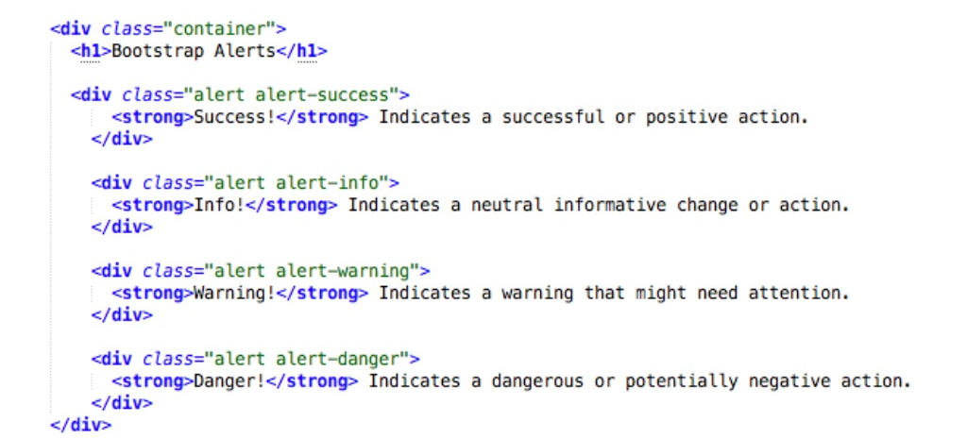
Alert - Example

Slide 34
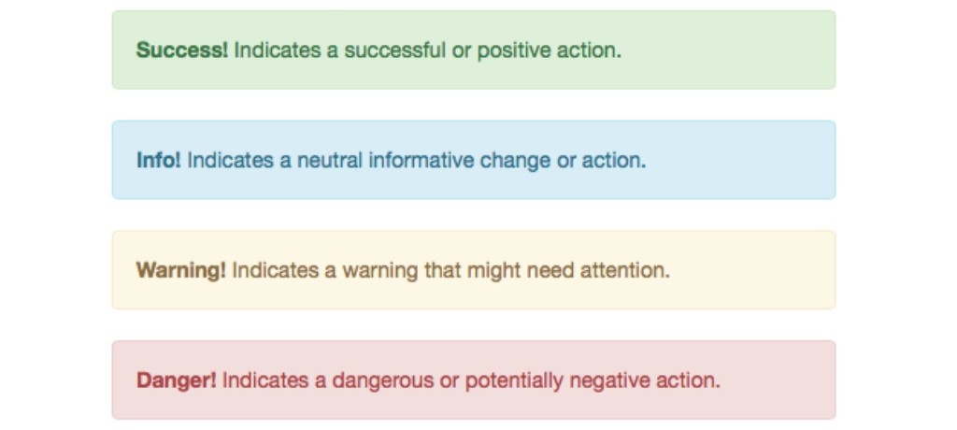
Alert - Example

Slide 35
Bootstrap Buttons
Bootstrap provides 7 styles of buttons. We can use the btn class to obtain it.
btn-default
btn-primary
btn-success
btn-info
btn-warning
btn-danger
btn-link

Slide 36
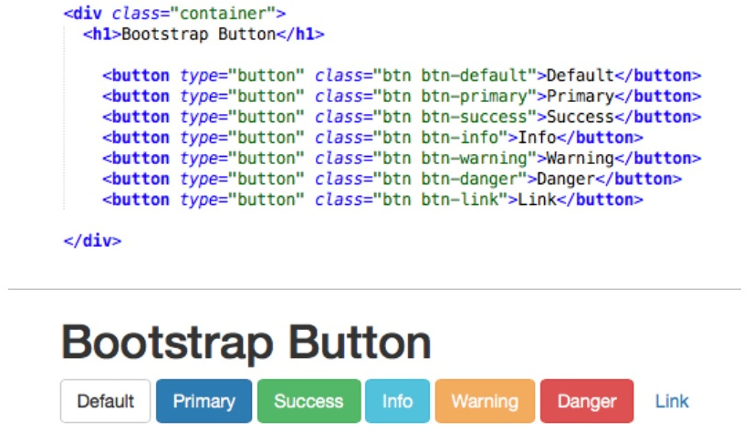
Buttons - Example

Slide 37
Spinners
It is used to create a spinner/loader.
We can use the spinner-border class to create it.
Syntax is,
<div class="spinner-border"></div>
By using contextual class we can change the color of the spinner accordingly.

Slide 38
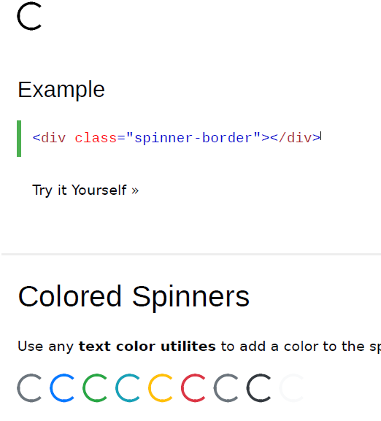

Spinners

Slide 39
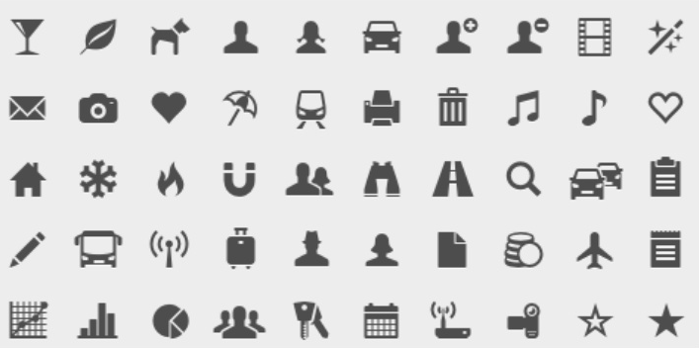
Bootstrap - Glyphicons
Bootstrap provides 260 glyphicons from Glyphicon Halflings set.

Slide 40
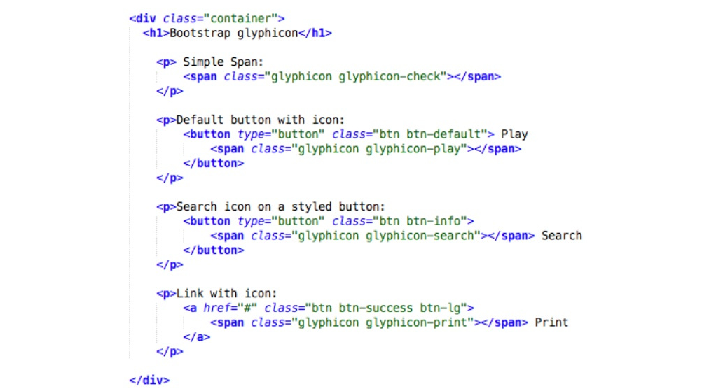
Glyphicons - Example

Slide 41
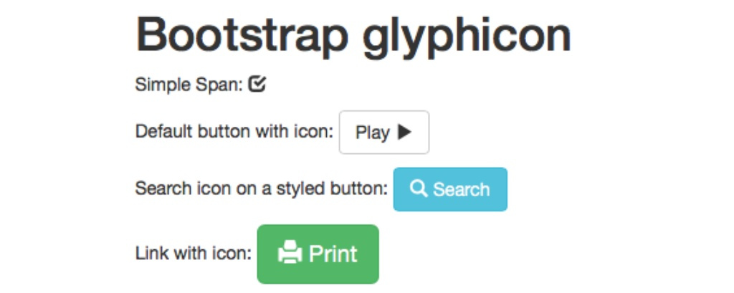
Glyphicons - Example

Slide 42
Bootstrap - Labels
Used to provide information about something.
We can create labels with colorful backgrounds to highlight the text.
Use the label class followed by one of the six contextual classes.
label-default label-primary
label-success label-info
label-warning label-danger

Slide 43
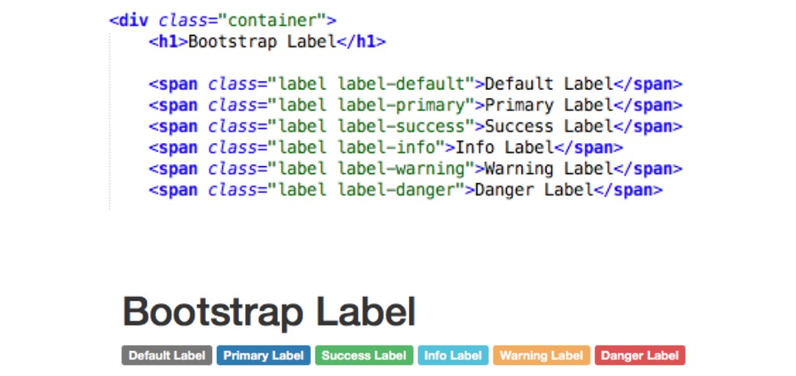
Labels - Example

Slide 44
Bootstrap - Panels
It is a bordered box with some padding around it’s content that can be used to highlight or separated from information.
Like other classes it is also used with contextual classes.
panel-default panel-primary
panel-success panel-info
panel-warning panel-danger

Slide 45
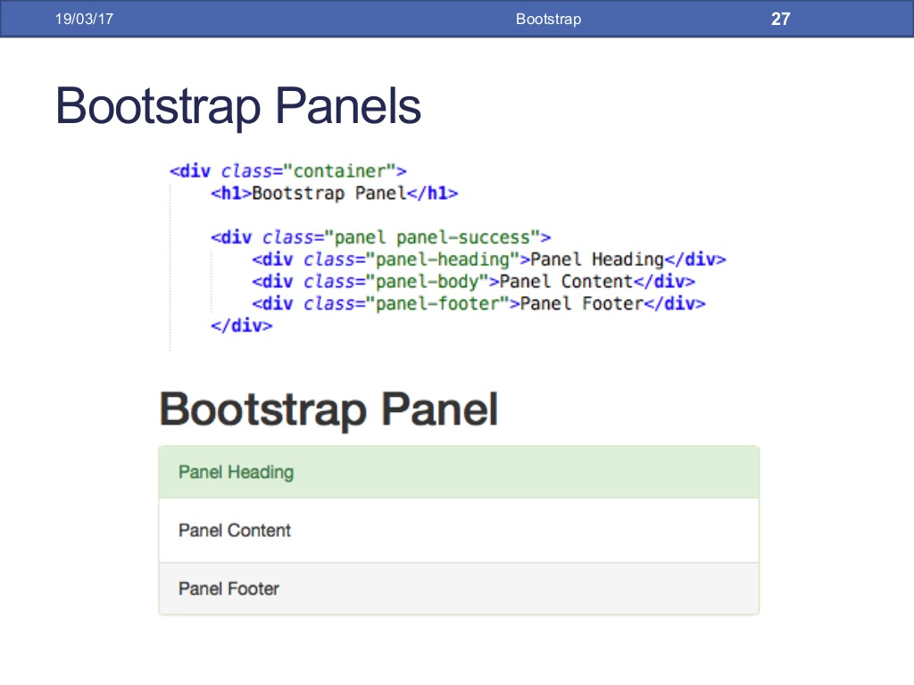
Panels - Example

Slide 46
Bootstrap - Forms
Form controls automatically receive some global styling with Bootstrap.
All elements with class form-control have a width of 100%.
It provides following types of layout,
Vertical form (default)
Horizontal form
Inline form

Slide 47
Vertical Forms
It is the default form layout.
Wrap labels and controls in a <div> with a class form-group, which is used for optimum spacing.
Add the class form-control to all the elements

Slide 48
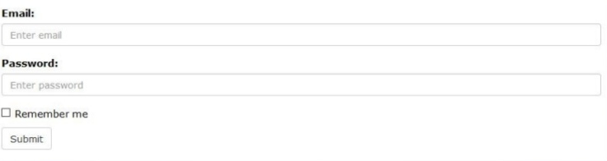
Vertical Forms

Slide 49
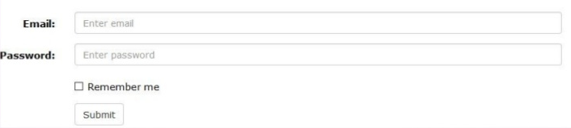
Horizontal Forms
Add the class form-horizontal in the <form> tag.
Add the class control-label to all labels in form.

Slide 50
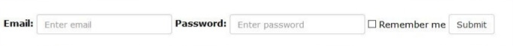
Inline Forms
It is used align all the elements of form in a line and left aligned.
Add the class form-inline in <form> tag.
This only applies to form within viewports that are at least 768px wide.

Slide 51
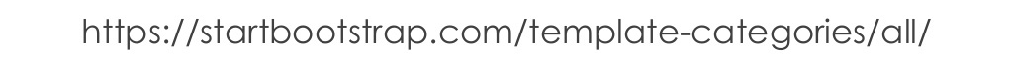
Bootstrap - Themes & Templates
We can find and download several themes & templates.
A theme consist of customized CSS.
A template consist of one or more predesigned Html pages, which often make use of theme.
Both are collection of bootstrap elements (Grid, buttons, panels, etc.).

Slide 52
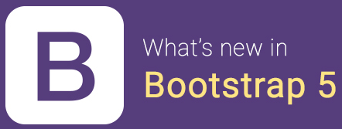
Bootstrap 5 is coming !
Dropped jQuery
Responsive containers
Using as module
Refreshed website

Slide 53
Conclusion
Bootstrap is a free and open-source CSS framework directed at responsive, mobile-first front-end web development.
It makes the responsive web designing more easy and effective.
It contains CSS, jQuery / Javascript that makes the designing more easier.

